Slide 1
Adaptive Information System Final Project - Anime Adaptive Recommendation System
Xiang Liu, Ben Ying,
Yuling Chen, Qizhou Huang

Slide 2
Introduction
Item-based collaborative filtering algorithm
Efficient
Stable
Contribution
Implement the system successfully
Besides using full data, select small amount of sets and test the results
Remove useless functions(focus on core part)
Enrich the anime detail page by using external api and information extracted from website(descriptions, images,videos)
Notes:
Collaborative filtering technique becomes more and more important nowadays for recommendation system. Our goal is to apply the knowledge learned in class with real-world anime data.
2. Challenges
Huge dataset
Algorithm selection

Slide 3
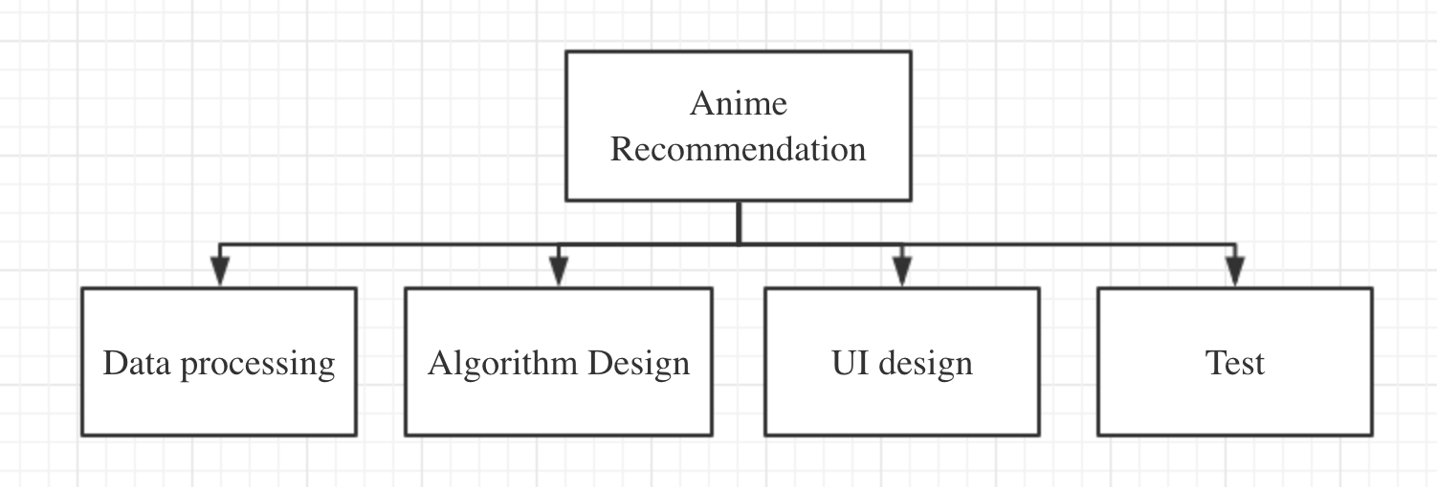
2. Task Analysis

Slide 4
3.1 Data Overview
The dataset contains information about 73,516 users’ rating on 12,294 animes, 7813738 ratings
records in total and some basic introduction of the animes.
Data from: https://www.kaggle.com/CooperUnion/anime-recommendations-database
myanimelist.net for providing anime data and user ratings

Slide 5
3.2 Data Description
Anime table
anime_id | randomly generated anime id
name | full name of anime
genre | comma separated list of genres
type | movie, TV, OVA, etc.
episodes | how many episodes in this show. (1 if movie).
rating | average rating
members | The number of user who rated
Rating table
User_id | randomly generated user id
Anime_id | the anime that this user has rated
Rating | -1 ~ 10

Slide 6
3.3 Data Preprocess
Rating table
remove -1 records
Anime table
convert the special characters
get representative top 10 genres
classify anime according to episodes
crawl posters based on the name
For recommandation, we get a subset of raw data
ratings 7697
user 167
anime 50
Select top 50 animes with most rating records and the users with more ratings, the 167 users all graded more than 45 animes of the top 50.

Slide 7
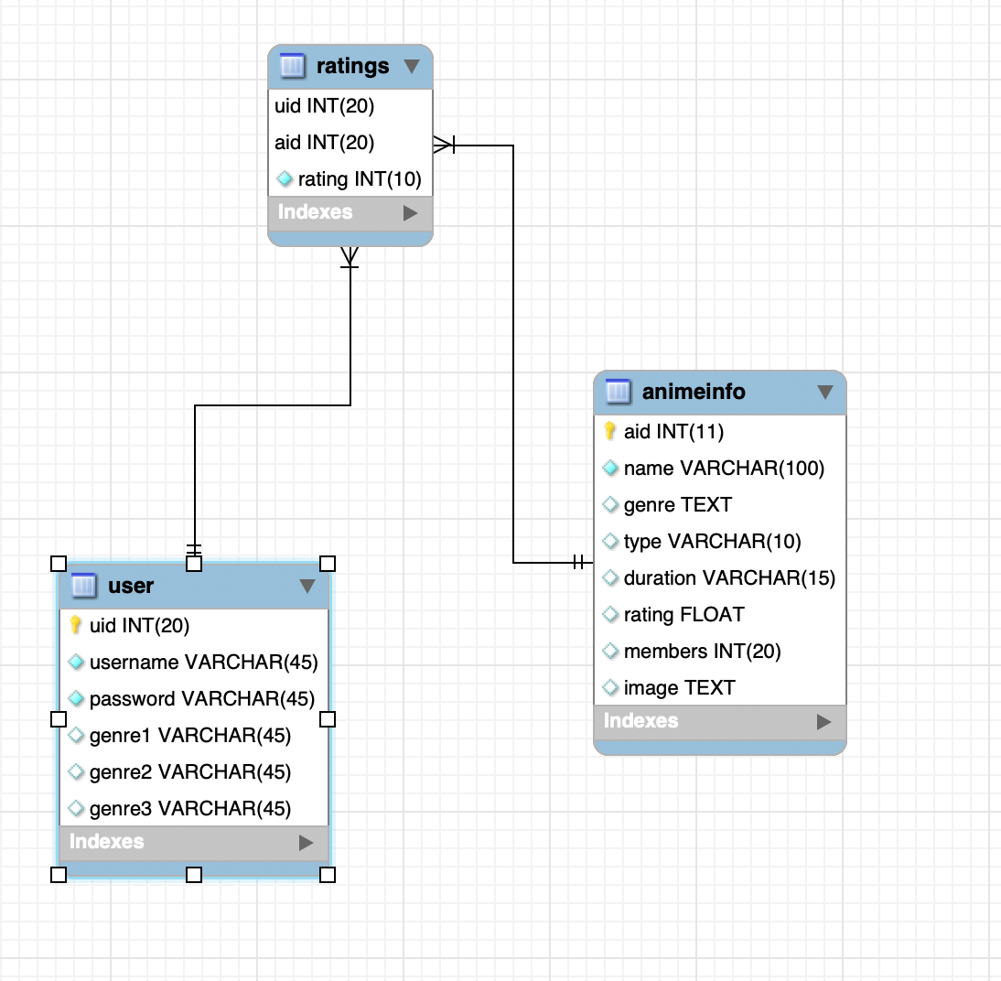
4. Database Design

Slide 8
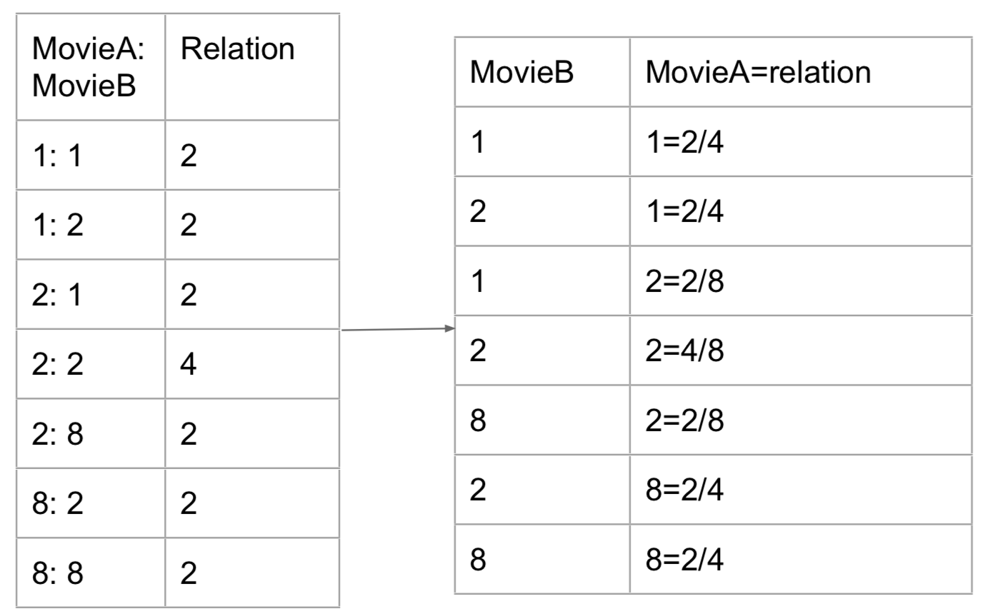
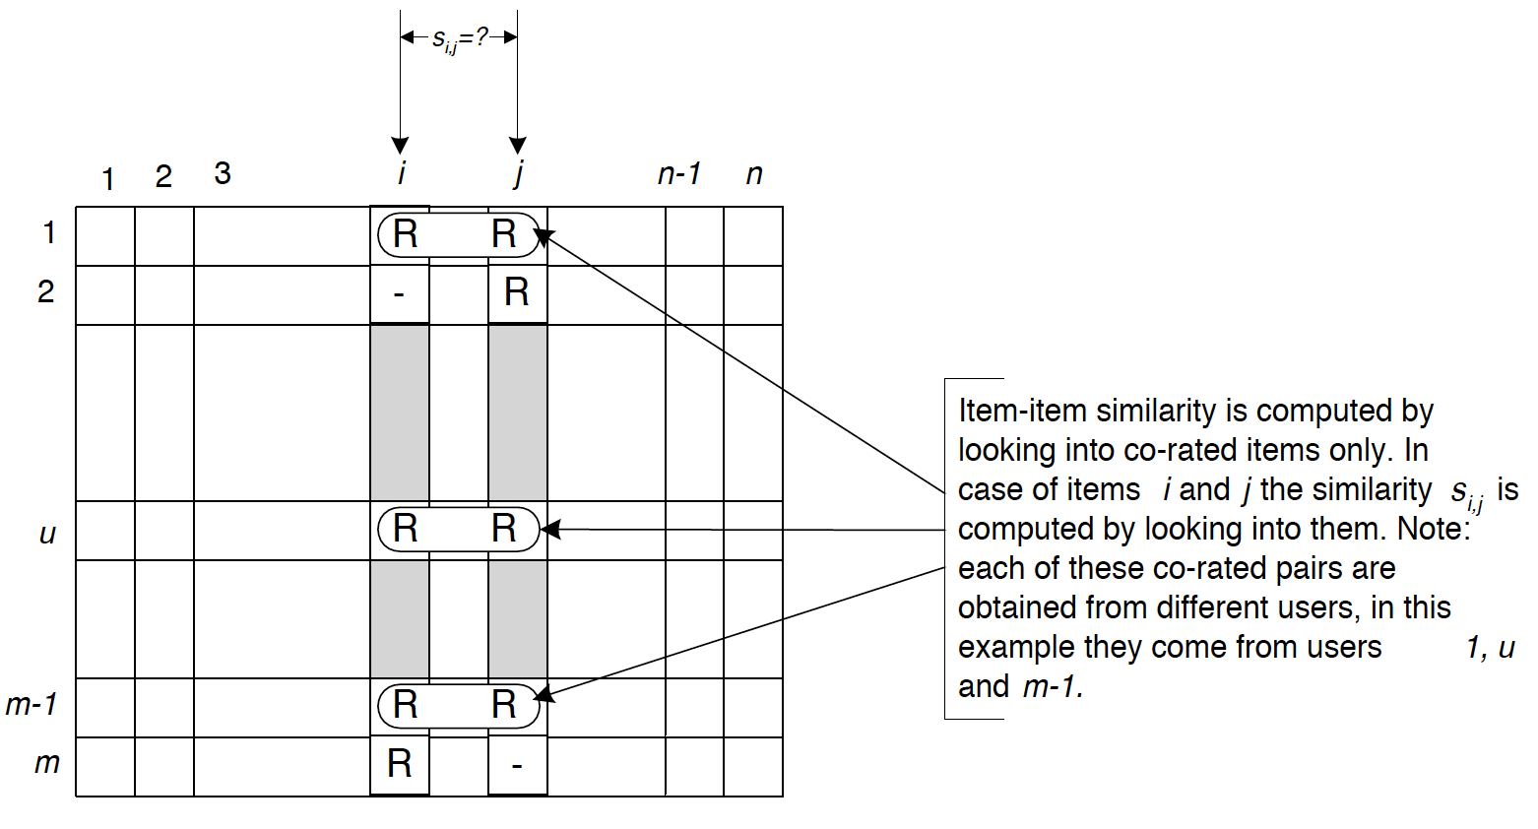
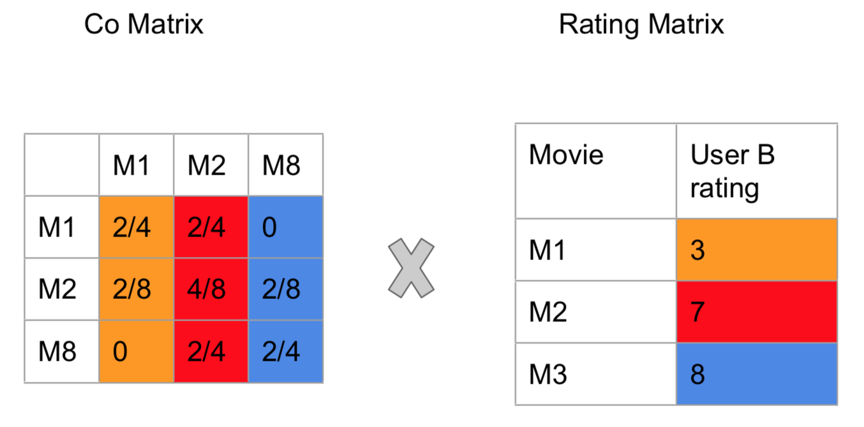
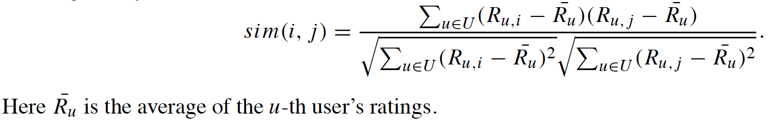
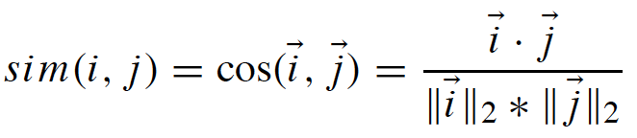
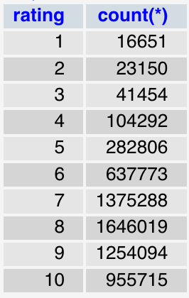
5.1 Algorithm of item based CF Evolution
(Didn’t implement correlation similarity considering the average rating of a item / anime )
Adjusted Cosine Similarity
(Consider user’s bias)

Slide 9
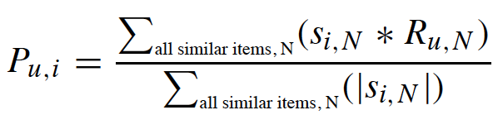
5.2 Implementation of item-based CF
Prediction -
Weighted Sum
Find the animes list that rated A and unrated B by current Login user
For every unrated anime b in list B, calculate the similarity with every anime a in list A
For each (b,a) pair, find their mutual ratings vector ub and vector ua that rated by same user
calculate the pure or adjusted cosine similarity (for adjusted, each rating in vector subtracts the average rating for related user)
For each b, using weighted sum and similarity array with each element in list A to calculate the predicted ratings for current user
Sorted as object and sort object based on rating value to recommend anime ID

Slide 10
5.3 Implementation of Recommendation
Backend : Node.js, Express.js
Database: MySQL
APIs: Youtube for video, Kitsu for description
Genres : prefixed with genres of most top 10 number of rated users.
Initial Animes for rating: dynamically show animes with most 10 num. of ratings
Recommendation based on trending: dynamically show animes with top 30 members.
Recommendation based on genres: dynamically show union of each genre for user top 3 animes based on avg.rating.
Recommendation based on ratings: dynamically show based on item-cf.

Slide 11
6. Design & Demo
Step 1 - full function showcase with top 50 animes database (low computation) using adjusted cosine similarity - “We need a fan to approve!”
10.215.47.42:3000/ to check on your computer
Step 2 - unsuccessful cf comparison with full data (6+M) using adjusted & pure cosine similarity

Slide 12
7. Takeaway & Limitation
Learned how the item based collaborative filtering works and how to implement
The ability to scale up needs to explore (Efficiency)
Avoid single rating for one user (the weight sum method will lead the user’s result with all same predicted ratings for unrated animes)
Increase efficiency by limit the number of mutual ratings for each item pairs(rated-unrated) similarity. Suggest to use certain threshold like 1% of whole user base
Increase accuracy by considering each user’s rating preference (use average user rating - adjusted cosine similarity)
Since item based similarity don’t often change, more realistic way to scale up might be pre-make similarity table in DB and using script to update weekly (especially for animes)

Slide 13

Thank you for your time!
Ben
Whisper
Qizhou
Xiang

